Slide 1
How to initiate fruitful contacts with local authorities in countries of origin
Usefull insights from the cooperation
Lyon Metropole – Tinca municipality
Social inclusion services
for the most deprived people

Slide 2
TINCA
LYON

Slide 3
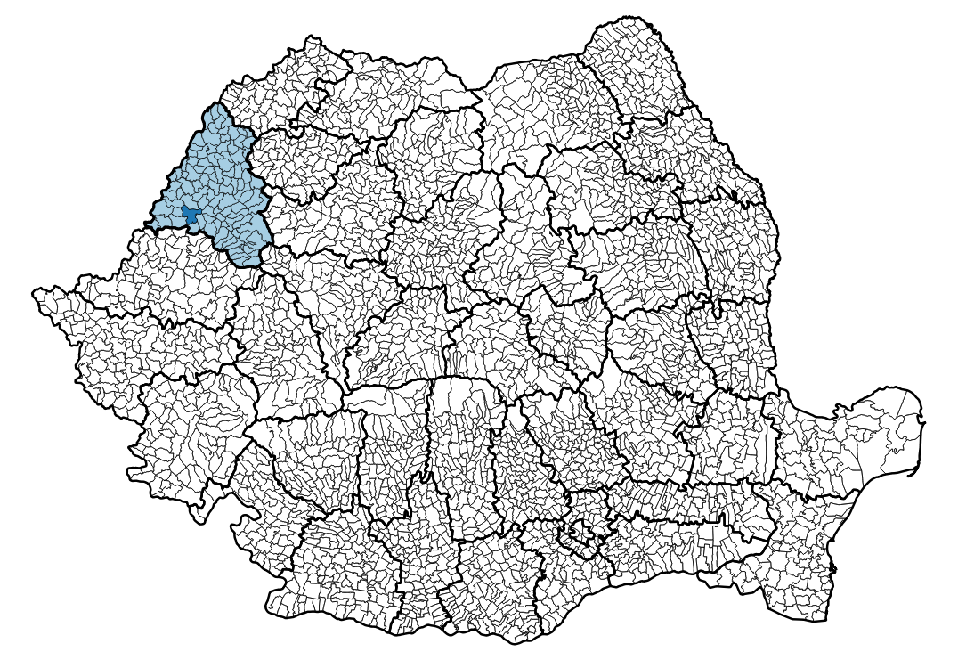
TINCA
ROMANIA

Slide 4
Public Decentralized Cooperation
Since 2011
From the situation in Lyon of deprived romanian roma people
Based on the posible role of local authority to help another municipality to improve municipal servicies

Slide 5
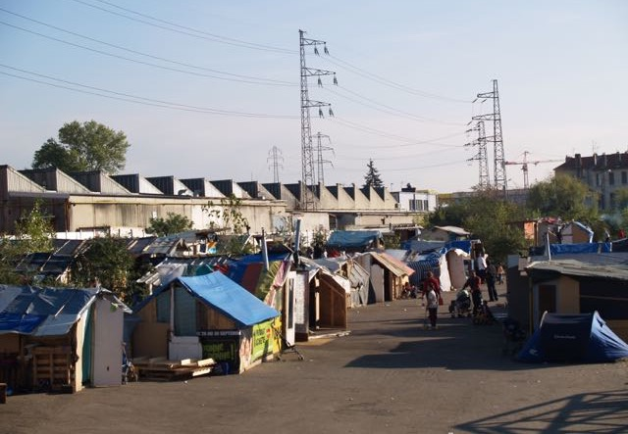

Slide 6
Romanian Roma in cities of France
It’s about 17.000 persons in France (official sources)
In about 400 slums and squats
Majority of Romanian people, mostly from Roma minority, familial profil
In Lyon since 1994, almost 2.000 persons (400 - 450 families)

Slide 7
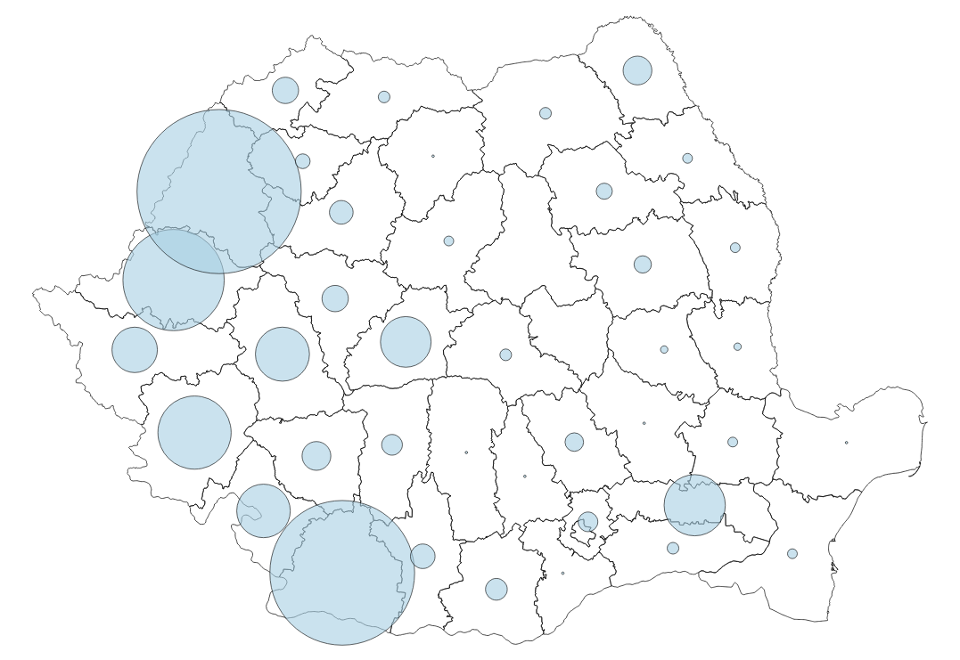
28%
BIHOR

Slide 8
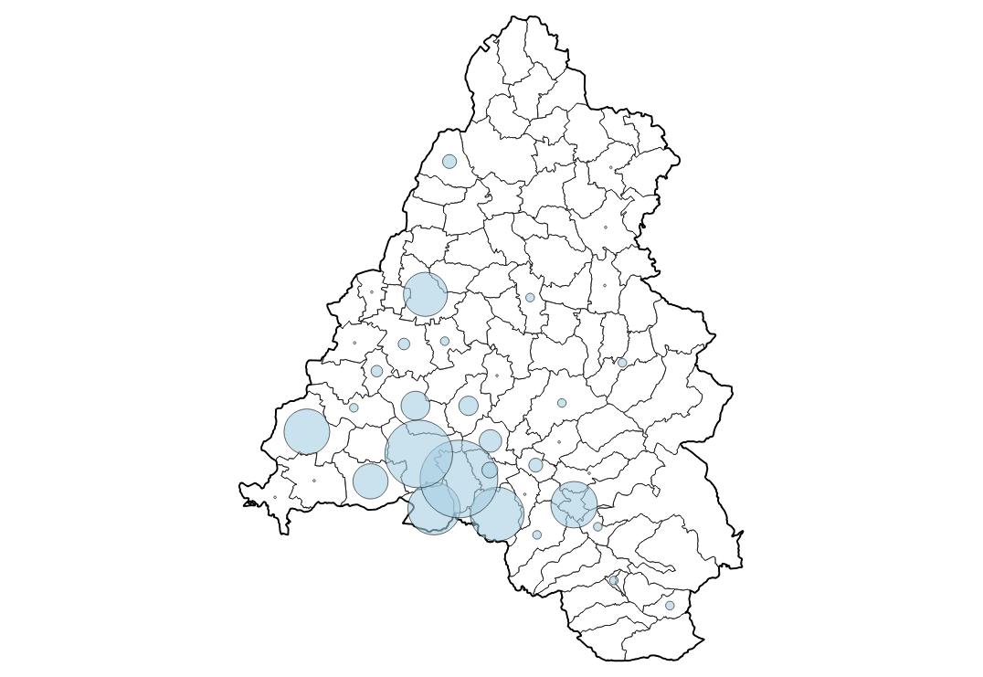
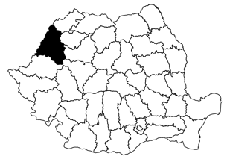
BIHOR
TINCA

Slide 9
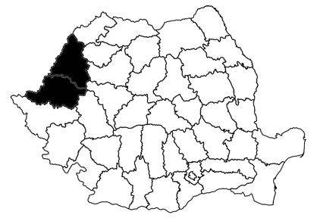
Majority of roma are coming from Bihor and Arad (more than 50%)
Often listen about « Tinca », it is a reality of the links between Lyon and Tinca! (Tinca is like a « landmark » or reference)
Working on the cause (poverty, exclusion, discrimination, non-access to social rights, etc.)
Entry by social, not community, group or cultural diferencies
Public partnership

Slide 10
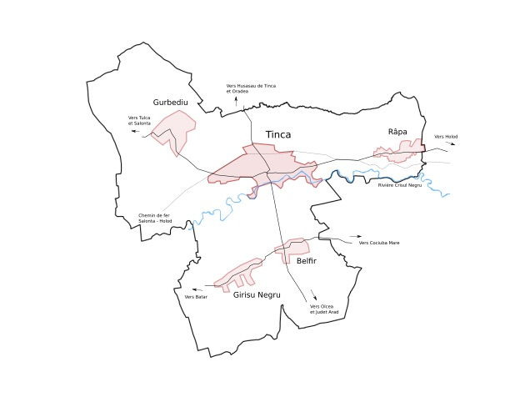
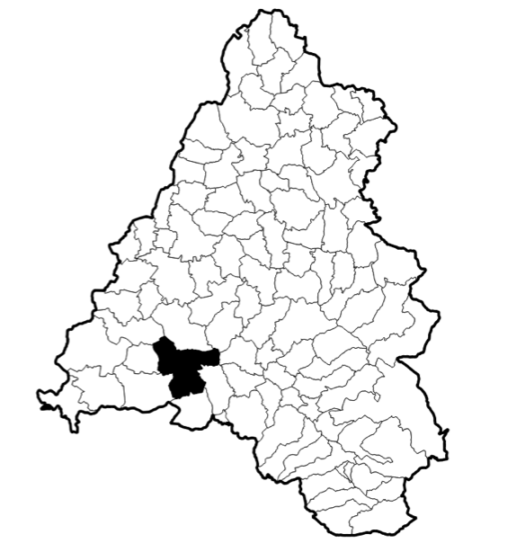
BIHOR
TINCA
5 villages
8300 inhabitants

Slide 11
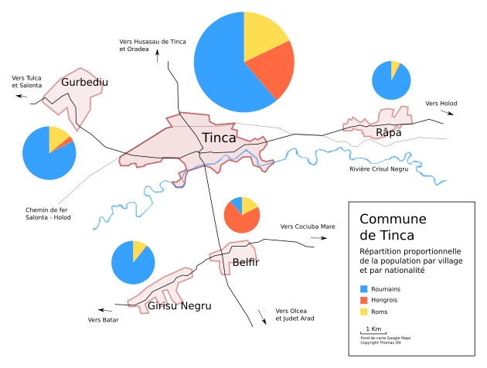

Slide 13
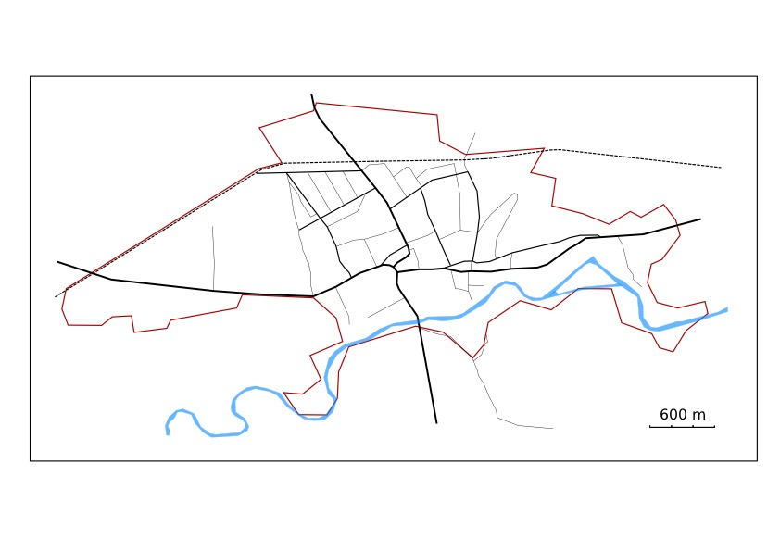
Roma neighborhood
City center

Slide 14
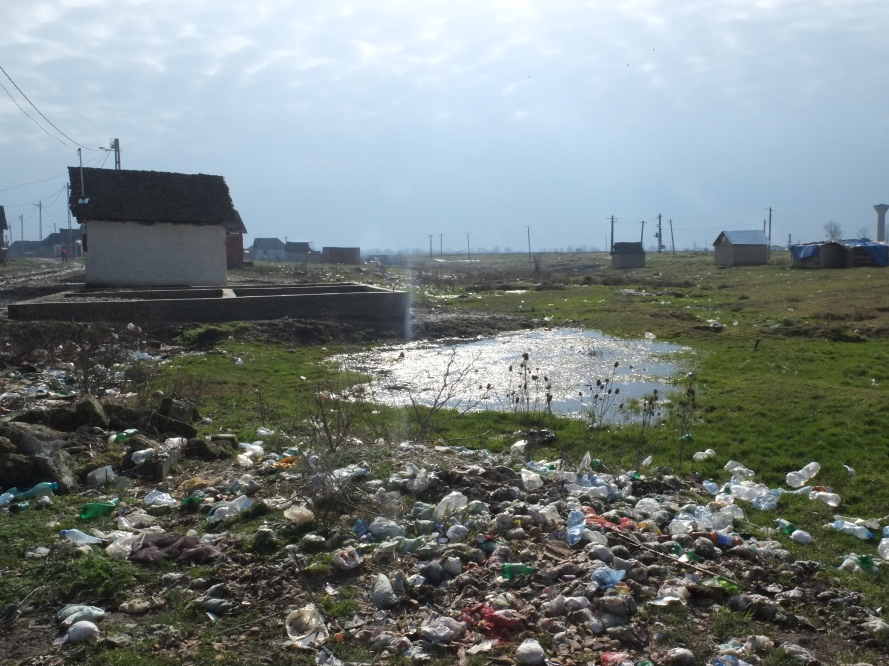

Slide 15
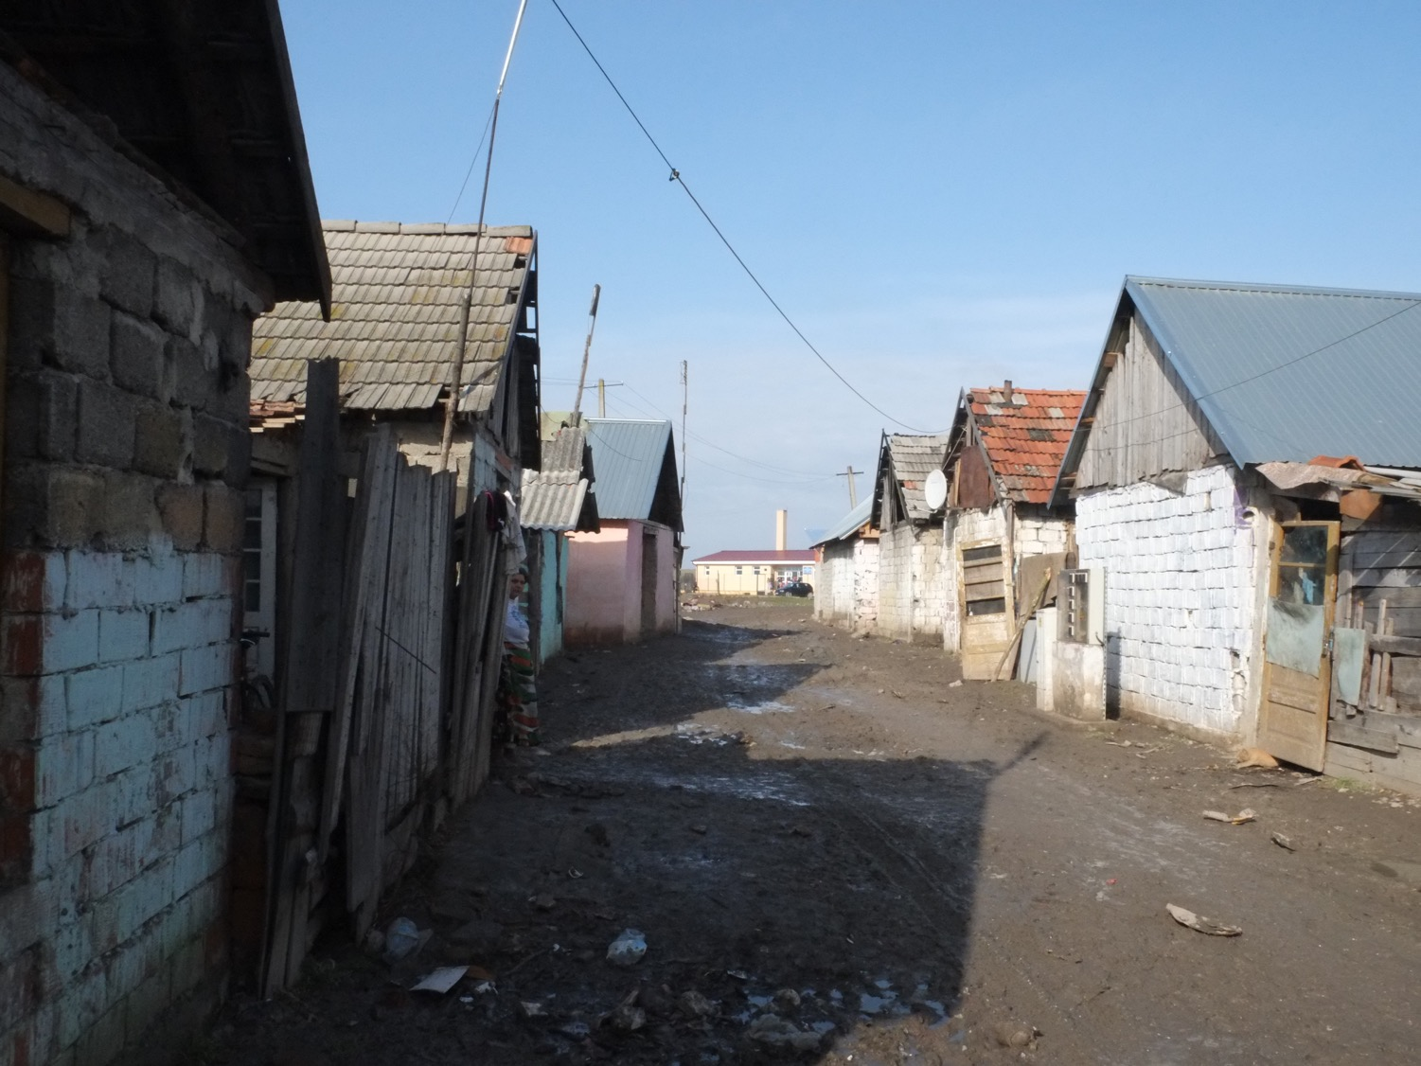

Slide 16
Romani community neighbourhood
Extreme poverty
Closed comunity (no transparency)
Comunity « leader » spokesperson
No good relation with the local authority
Urban development not managed (land property, sewage, garbage, etc.)

Slide 17
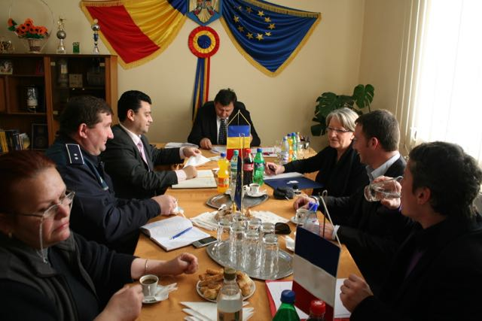
Working groups with other institutions

Slide 18
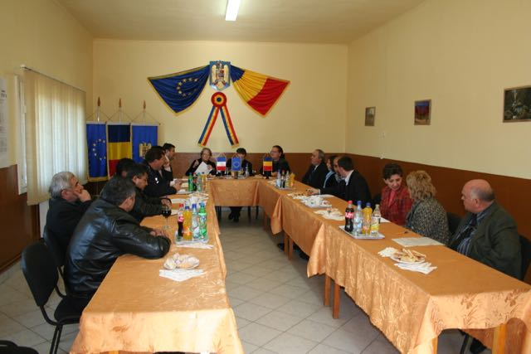
Romani spokspersons
Municipal officers

Slide 19
Need time to understand the aim of the partnership (public partnership not usually)
Imediat decisions (too quick)
No precis knwoledge of the situation by the mayor
Comunity « leaders » alone to know the comunity
Comunity « leaders » are Romani people
Comunity « leaders » as spokespersons
Also evangelic pastors
Obvious and unique « solutions »

Slide 20
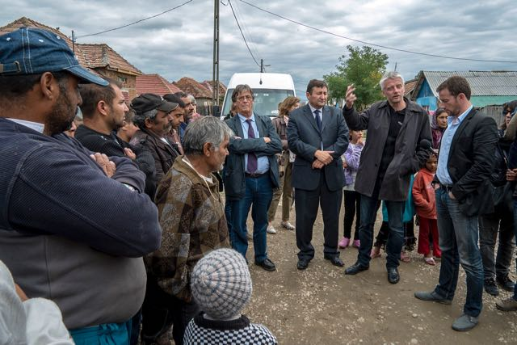
Public meetings

Slide 21
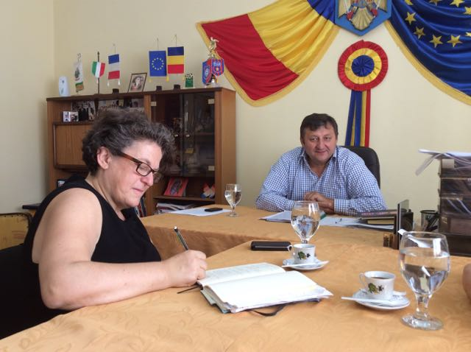
Short meetings with the mayor

Slide 23
Short term actions : electrifications, improvement of living conditions, etc.
Mid and long term actions : social center, public servicies and partnership
Pretext and strategic action :
Electrifications : public power grid and urban management, legalisation of some housholds
Social center : municipal social help service, public pertnerships (schools, employment agency)

Slide 24
Centre multifonctionnel
Adduction réseau assainissement
Première phase d’électrification
Zone d’attention
Extension réseau électrique et éclairage public
Deuxième phase d’électrification
Dispensaire
(projet externe)
Mairie

Slide 25
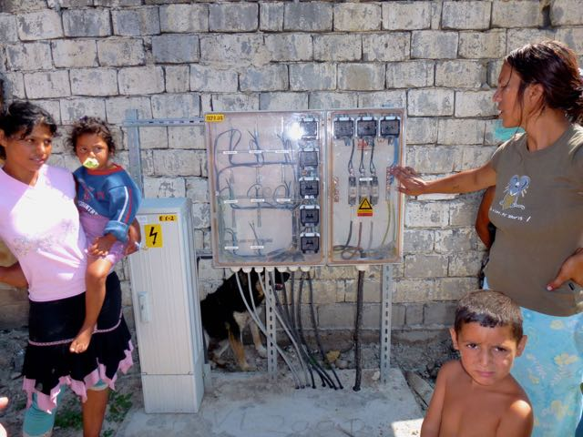
Electrifications

Slide 26
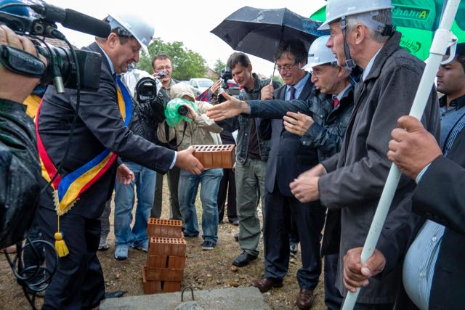
Construction of the municipal social center

Slide 27
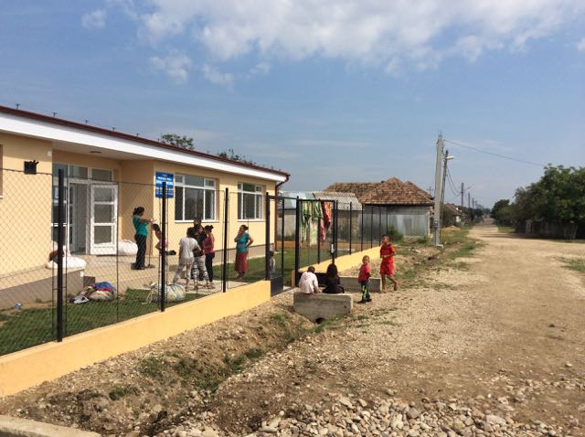
Municipal social center

Slide 28
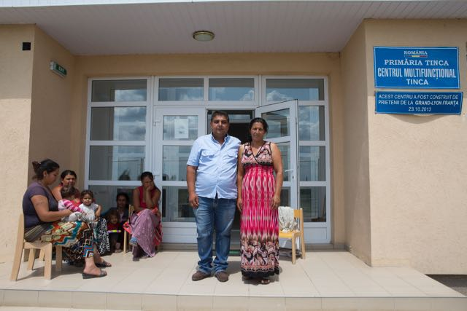
Romani employees

Slide 29
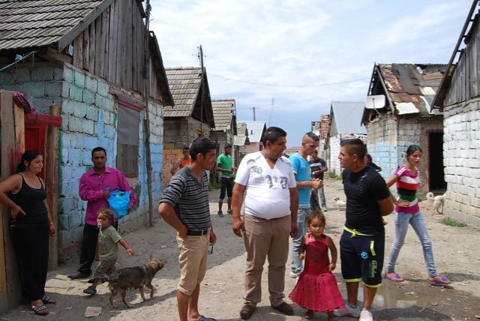
Social mediators

Slide 30
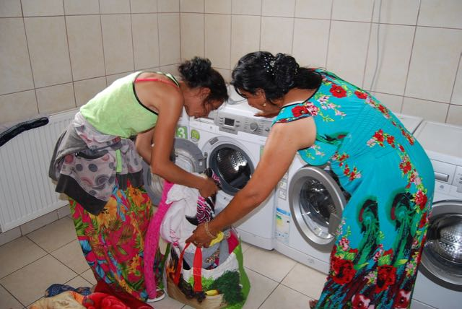
Open for all services

Slide 31
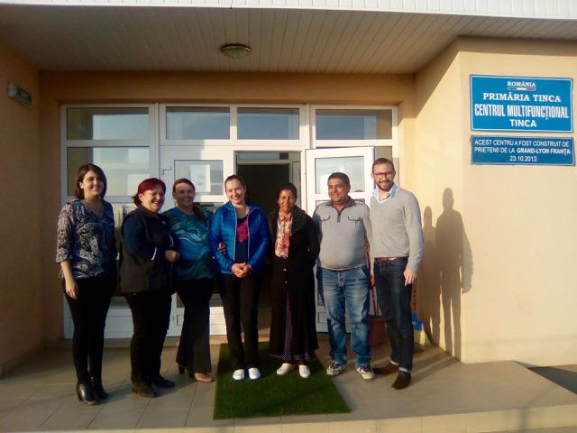
Multidisciplinary team

Slide 32
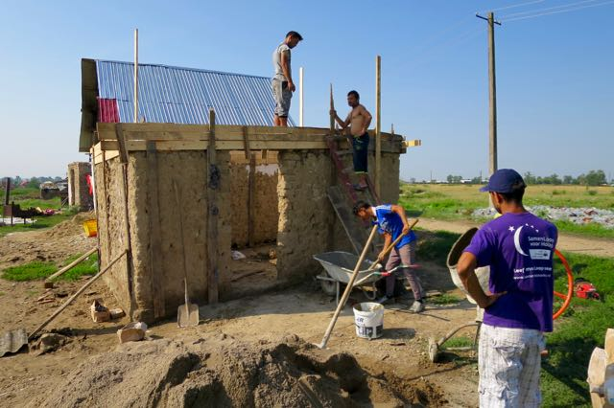
Repair works with the dwellers

Slide 33
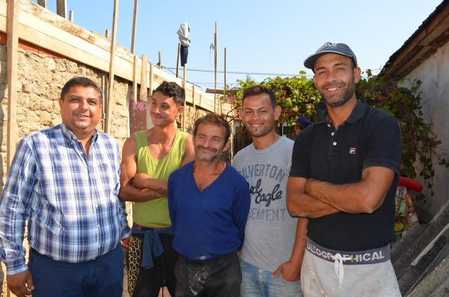
A team from the neighborhood

Slide 34
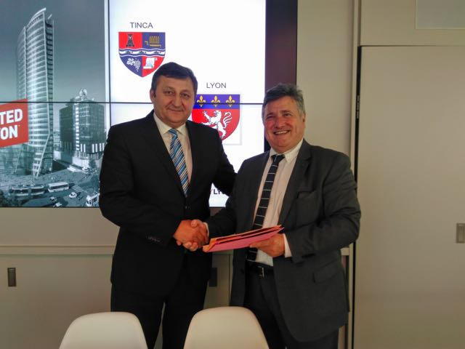
Key event also in Lyon

Slide 35
Thank you for your attention !
To contact us :
Thomas Ott
Chargé des programmes en Roumanie
ONG ITD Monde
58, rue Raulin
69002 Lyon – France
+33 6 27 36 64 10
thomas.ott@itdmonde.org

